Slide 1
Parallel Lines
Transversal lines
&
Mrs. Mac’s Class

Slide 2
Fair Use Disclaimer
This presentation was created following the Fair Use Guidelines for Educational Multimedia. Certain materials are included under the Fair use Exemption of U.S. Copyright Law.

Slide 3
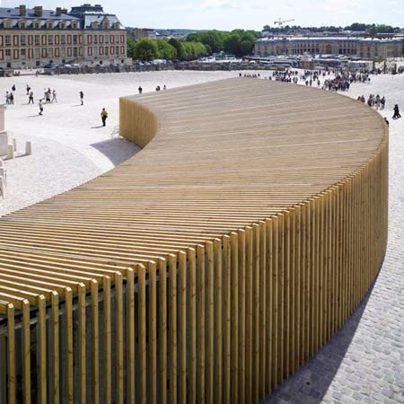
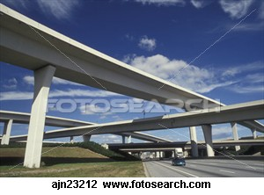
What is the difference between Parallel and Skew Lines?
Parallel
Skew
Lines that are in the same plane,
and never intersect.
Lines that are not in the same plane,
and never intersect.
http://archide.files.wordpress.com/2008/12/012.jpg

Slide 4
Symbols
Parallel
Not Parallel
Symbol:
Example:
Symbol:
Example:

Slide 5
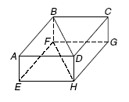
Examples
1.) Name all planes parallel to plane ABD.
2.) Name all segments that are parallel to CG.
3.) Name all segments that are skew to EH.
Glencoe McGraw Hill Geometry Book copyright 2004, ISBN 0-07-866876-X

Slide 6
What is a Transversal?
A transversal is a line that intersects two or more lines at different points.

Slide 7
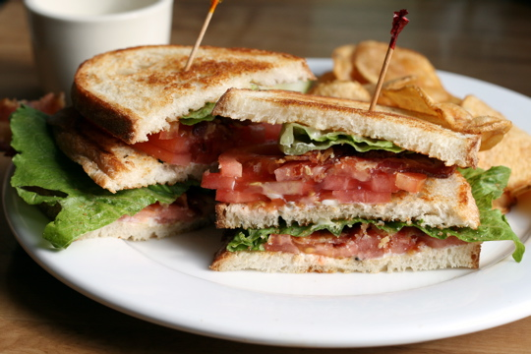
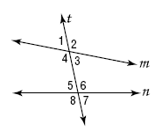
Special Angle Names
Imagine a sandwich.
Lines m and n are represented by the bread and the transversal line is the toothpick.
http://g-ecx.images-amazon.com/images/G/01/askville/291827_9042666_mywrite/blt.jpg
Name | #’s
Interior Angles
Exterior Angles
Alternate Interior Angles
Alternate Exterior Angles
Consecutive Interior Angles
Corresponding Angles
Glencoe McGraw Hill Geometry Book

Slide 8
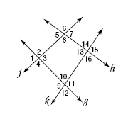
Examples
Name the transversal that forms each pair of angles.
Then identify the special name for each angle pair.
1.) 4 and 10
2.) 2 and 12
3.) 7 and 3
4.) 13 and 10
Glencoe McGraw Hill Geometry Book copyright 2004, ISBN 0-07-866876-X

